Slide 1
In order to apply, you must first complete the online registration.
Once you have completed the registration, with your UserID and password you can begin the application’s submission by clicking on «Online Application» on each PhD course webpage

Slide 2
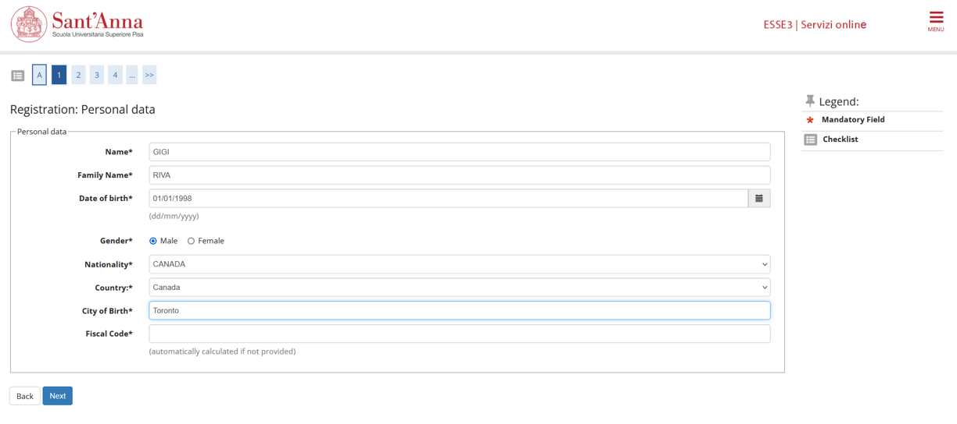
During registration, pay attention to this step
If you don’t have an Italian fiscal Code, leave this field blank and click on «Next»: the system will automatically calculate it

Slide 3
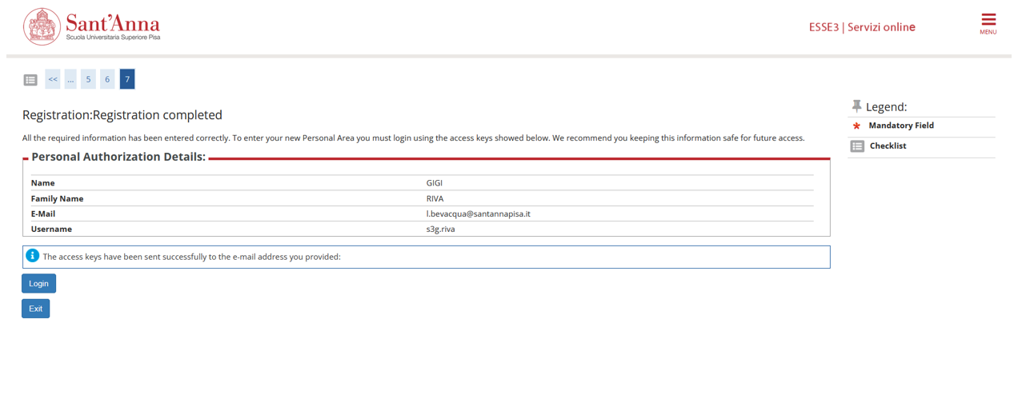

Slide 4
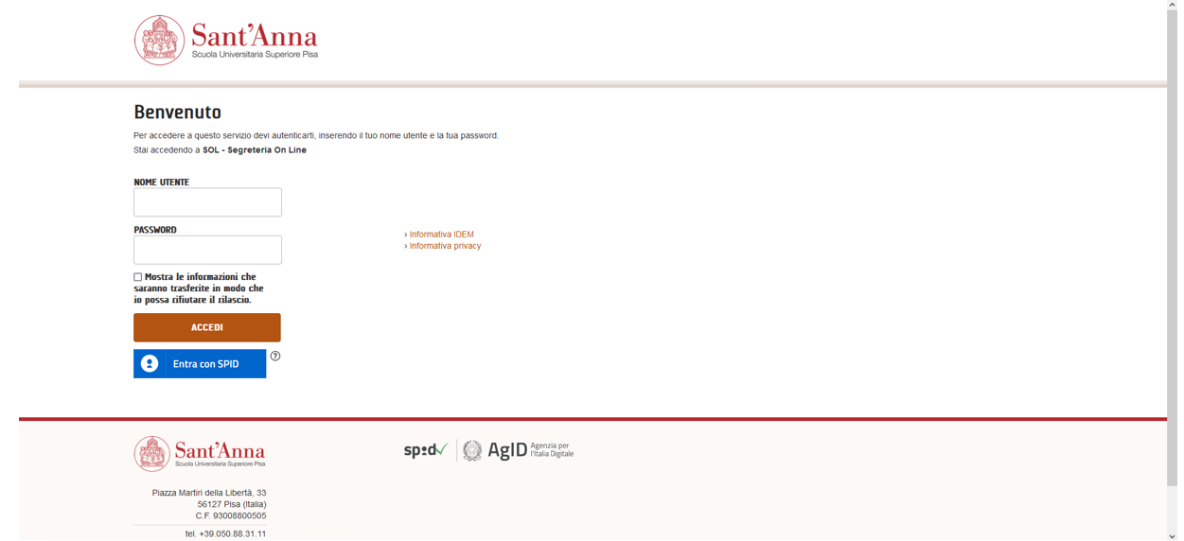
Access the application form using your UserID and password

Slide 5
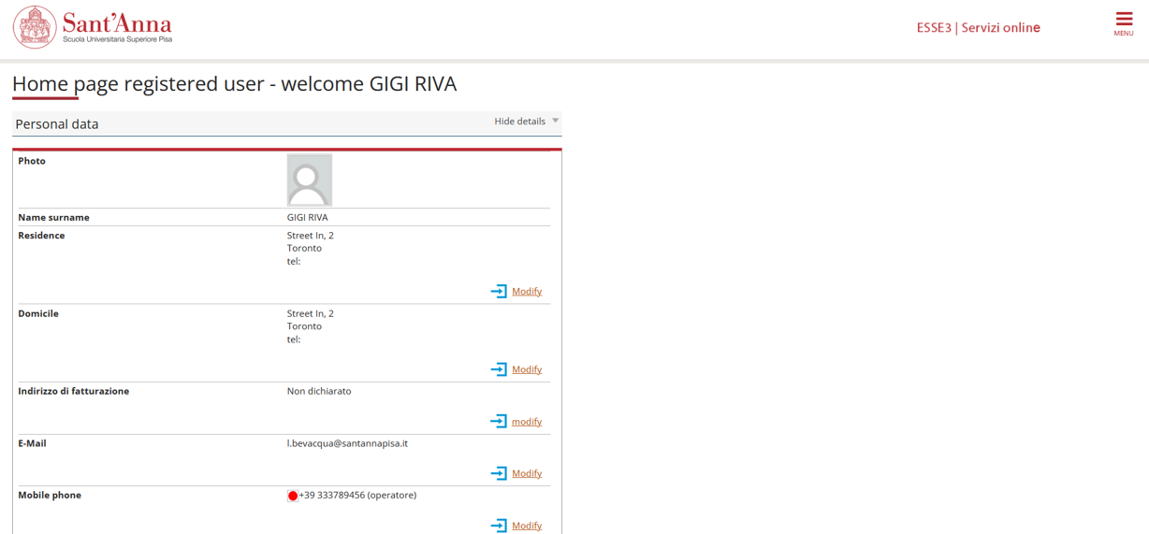
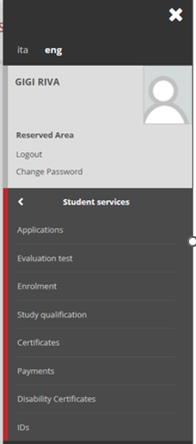
How to apply? Once you access the Home Page, click on this top-down menu
choose «Student services» and then «Applications»

Slide 8
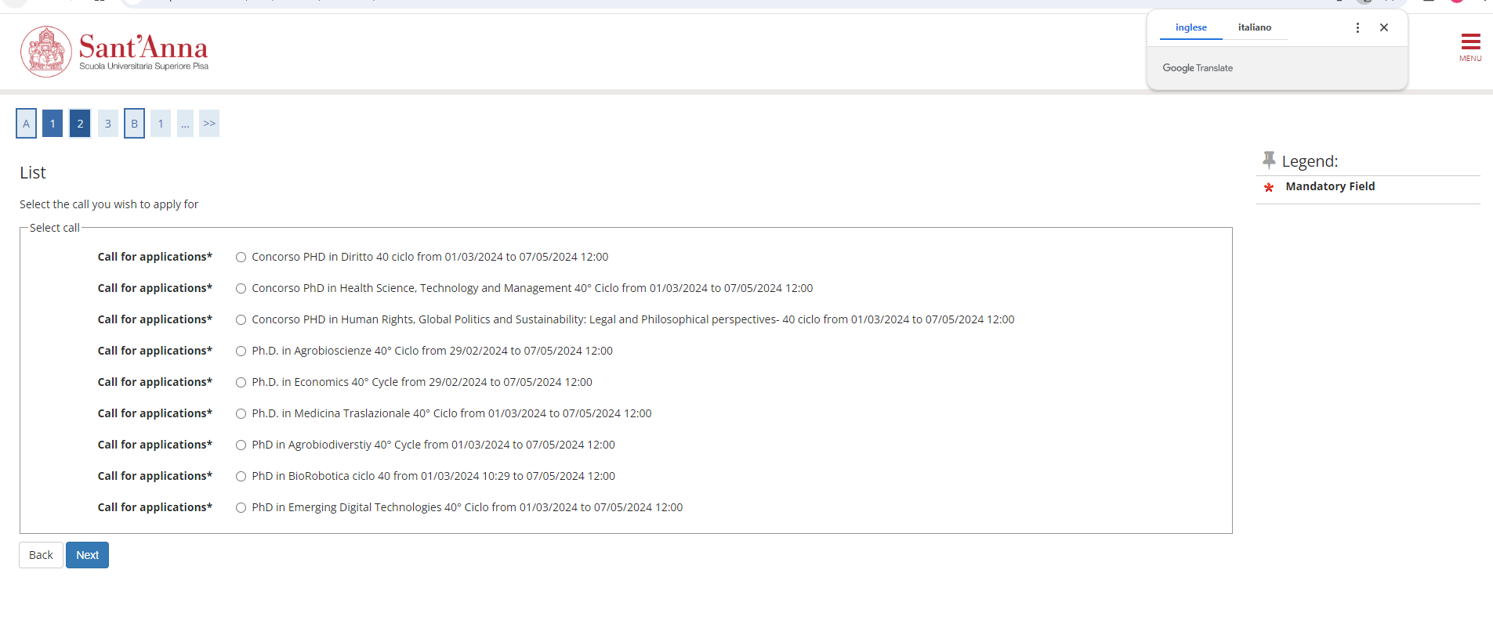
Select the Ph.D. Program of your interest and click on «next»

Slide 12
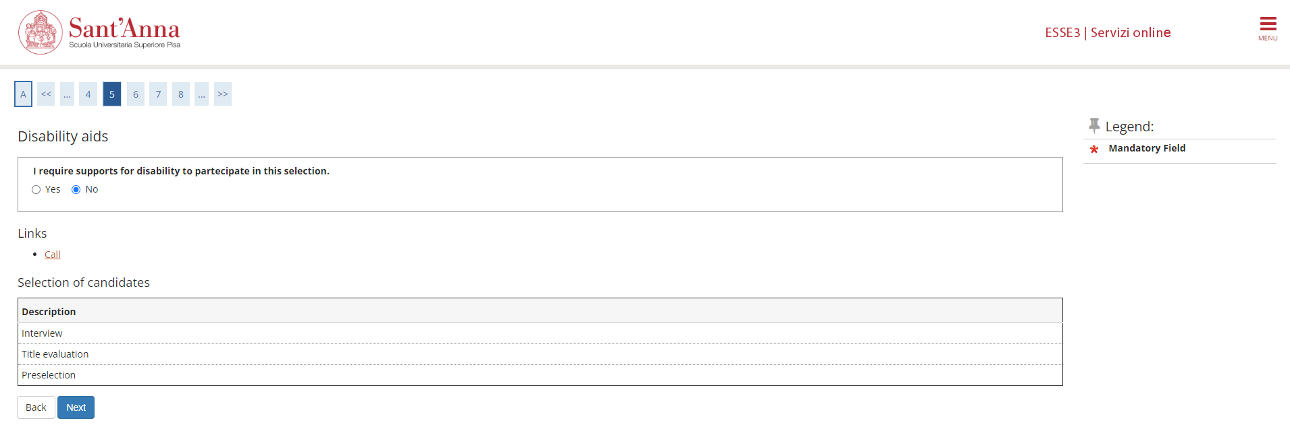

Slide 13
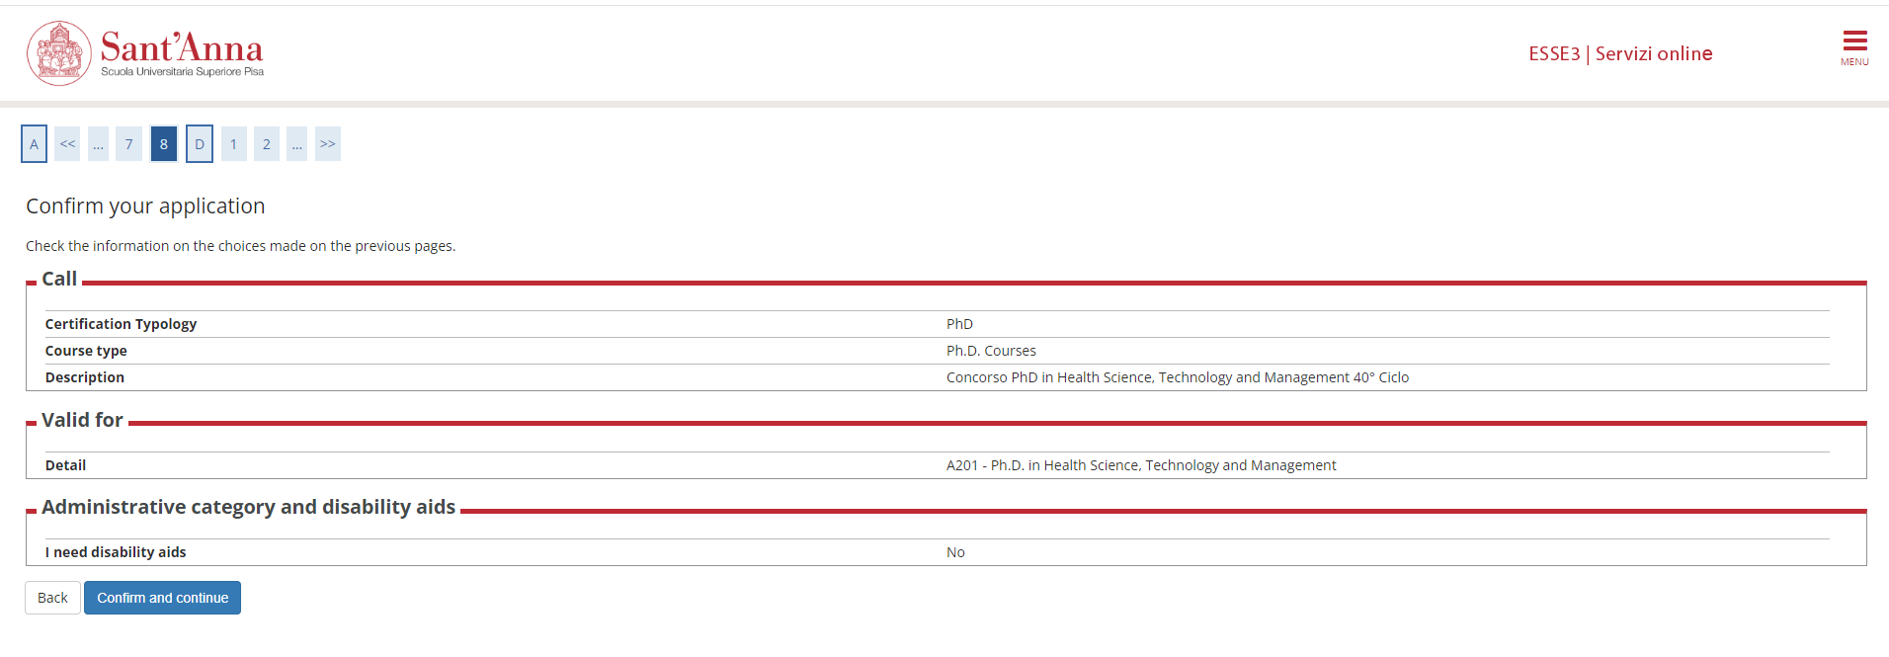

Slide 14
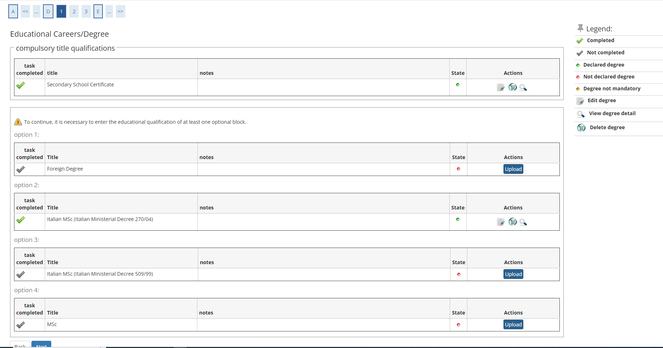
PLEASE NOTE: once you upload your qualifications, you must select the correct title combination. Please select «secondary school qualification AND and academic qualification (foreign Degree or Italian M.Sc.)» and then click on «Next»

Slide 15
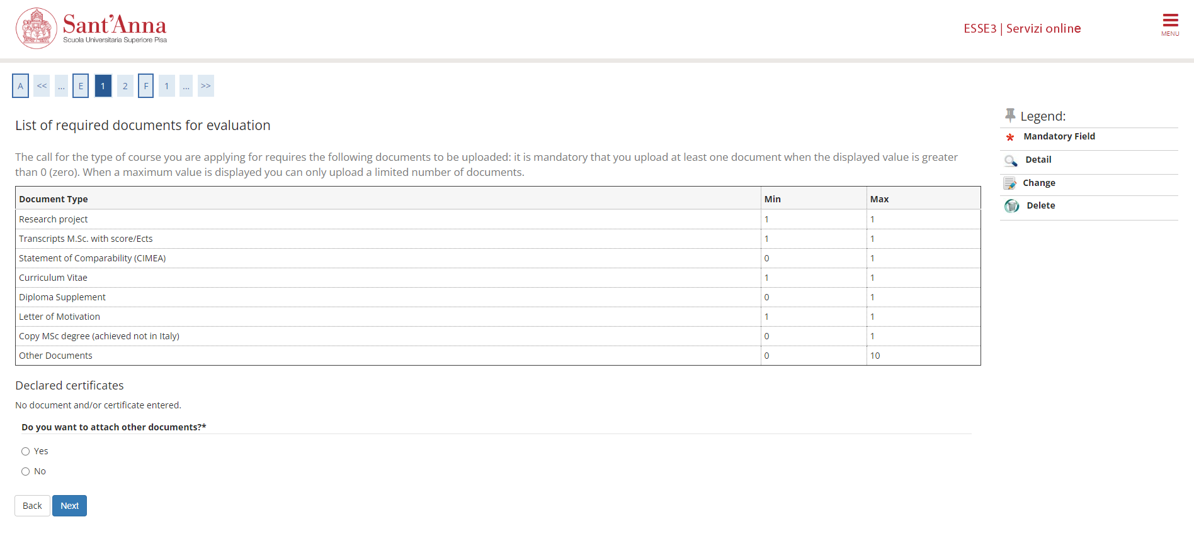
Now you have to upload all the documents: click on «Yes» and then on «Next»

Slide 16
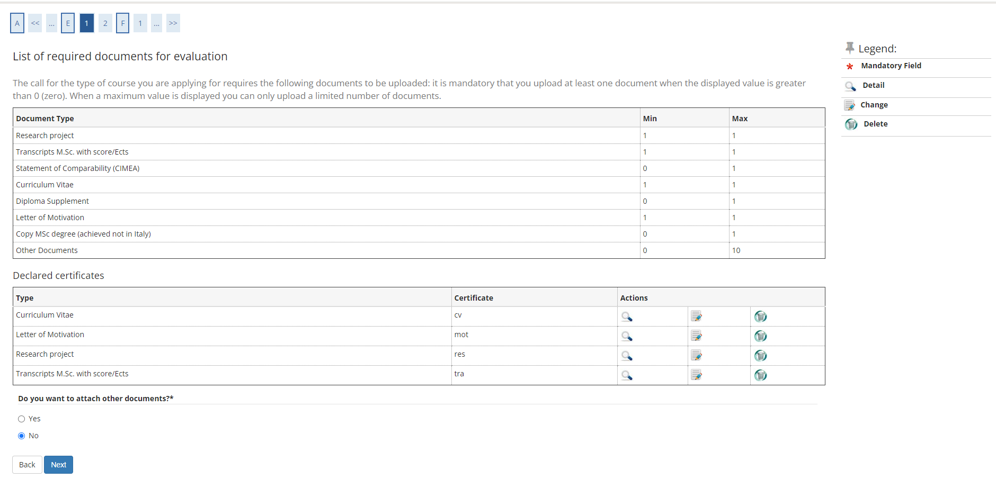
When you have finished uploading, click on «No» and then on «Next»

Slide 18
OPTIONAL: If required by the Factsheet of the PhD program of your interest, you can now enter your referees details by clicking on «Insert reference request»

Slide 19
When you have finished , your referees details will be listed here. To continue click on «Next»

Slide 20
In this section, you are requested to provide some mandatory information. Failure to complete this mandatory section will result in exclusion from the selection. Click on «Fill out»

Slide 21
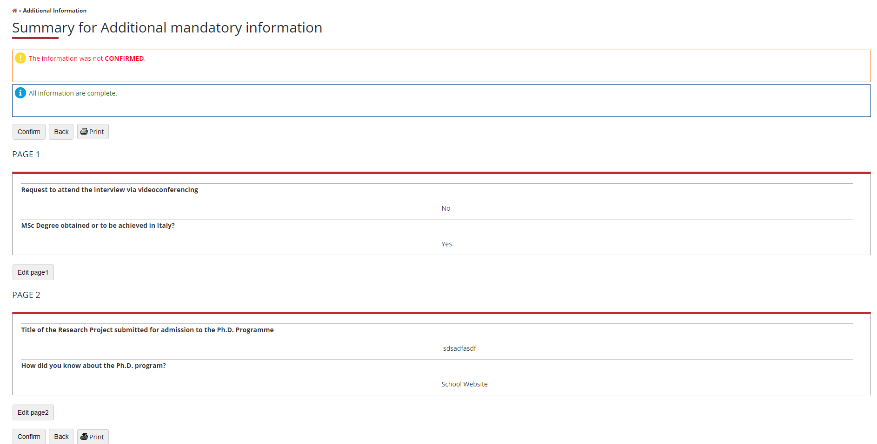
Once completed, click on Confirm

Slide 22
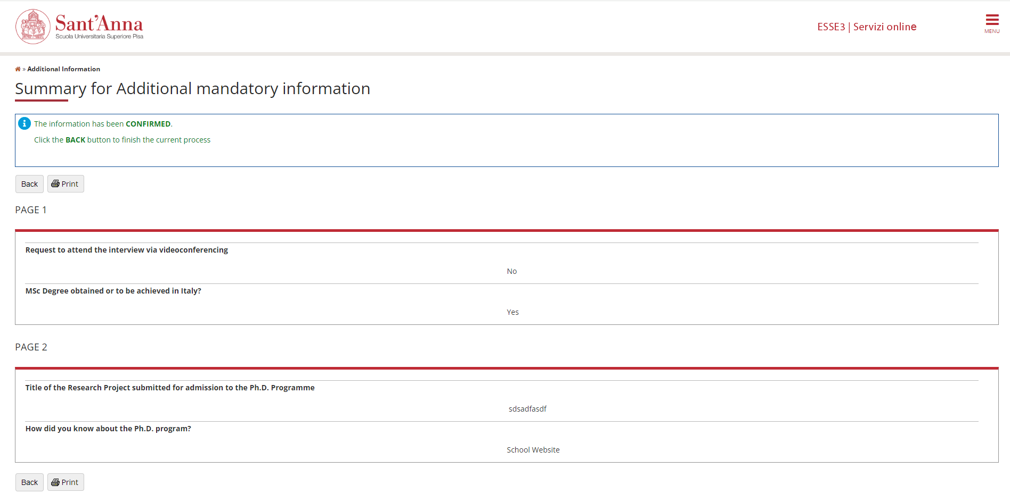

Slide 23
When the Status shows a green icon you can click on « Next »

Slide 25
Click on «Submit your application». If the application is submitted correctly, you will receive a confirmation email

